Slide 1

Retail Sales Forecasting Pipeline
Kimi AI
2025/08/01

Slide 2








Kick-off
Feature Craft
Disaggregation
EDA Insights
Model Build

Slide 3
Evaluation
Next Steps

Slide 4
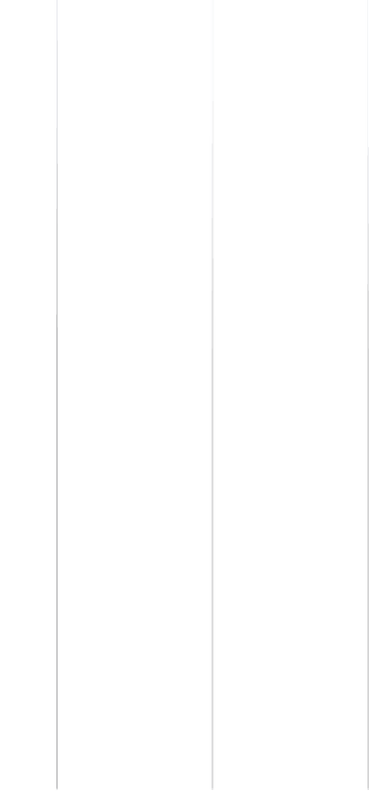


01
Kick-off

Slide 5

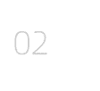

Project Goal and Data Scope
Project Objective
Data Structure
Our goal is to predict daily product-level sales for five countries, three stores, and five educational technology products from 2017 to 2022. The raw training set includes 1826 unique dates with features like date, country, store, product, and number of items sold. Success is measured by RMSE on disaggregated forecasts.
The training dataset contains 1826 unique dates with features such as date, country, store, product, and the number of items sold. The test dataset mirrors this structure but lacks the target variable. The objective is to achieve high accuracy in predicting future sales based on historical data.

Slide 6




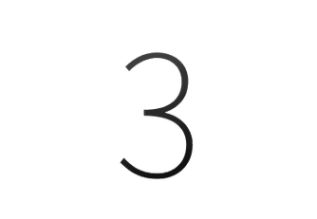
Toolkit and Workflow Outline
Technology Stack
Pipeline Stages
Model Selection
We will use Python with Pandas for data manipulation, Matplotlib and Seaborn for visualization, scikit-learn for preprocessing, and LightGBM for regression. This comprehensive toolkit will support each stage of the pipeline.
The workflow includes data loading, cleaning, exploratory data analysis, feature engineering, model training with GroupKFold cross-validation, total sales forecasting, product-level disaggregation, and RMSE evaluation.
LightGBM is chosen for its efficiency and performance in handling large datasets. It will be trained using a GroupKFold strategy to ensure robust validation and prevent temporal leakage.

Slide 7
02
EDA Insights

Slide 8


Sales Trend and Seasonality
Monthly Aggregation
2020 Deviation
Rolling Means
Monthly aggregation of sales data reveals a steady upward trend and clear yearly seasonality. This indicates consistent growth and predictable peaks and troughs throughout the year.
The year 2020 shows a deviation from the norm, with higher mid-year peaks likely driven by pandemic lockdowns. This anomaly highlights the need for careful handling of such periods in the model.
Calculating 7-day and 30-day rolling means helps smooth out weekly noise and highlights long-term trends. This provides a clearer picture of the underlying sales patterns.

Slide 9



Country Sales
Country and Product Patterns
Product Sales
Argentina leads in sales volume, followed by Brazil, Canada, Mexico, and the United States. This indicates varying market demand and potential regional preferences.
Product sales are relatively balanced, with a slight edge to the 'Using LLMs to Improve Your Coding' course. This suggests a well-diversified product portfolio.

Slide 10

Anomaly Detection in 2020
Daily totals from March to May 2020 show irregular spikes and drops, likely due to the pandemic. We exclude this 92-day window to prevent model drift, ensuring stability in the training data.
Exclusion of Anomalous Period

Slide 11
03
Feature Craft

Slide 12




Date and Cyclical Encoding
Date Features
Cyclical Encoding
Weekday Binning
Extract year, month, day, weekday, and day-of-year from the date column. These features capture temporal patterns and seasonal effects.
Apply sine-cosine pairs to month and day to preserve their cyclical nature. This helps the model understand repeating patterns like monthly and daily cycles.
Encode weekday as four bins to capture the weekend effect. This simplifies the model's understanding of weekly trends and reduces complexity.

Slide 13

Holiday and Easter Features
Holiday Mapping
Map holidays for Argentina, Canada, Estonia, Japan, and Spain using the holidays library. Create binary is_holiday and ordinal holiday_name features to capture special events.
Easter Features
Generate Easter window dummies for ±5 days and 40-47 days post-Easter to capture spring sales lifts. Encode unseen holidays as 'Not Holiday' to maintain consistency.

Slide 14



Important Dates and One-Hot
Feature Engineering
Mark important dates like the start and end of the year and mid-year peaks. Apply one-hot encoding to these dates, weekdays, and Easter windows. Drop raw date, month, and day to reduce leakage.

Slide 15
04
Model Build

Slide 16


GroupKFold Strategy
Temporal Grouping
Cross-Validation
Use year as the group to avoid temporal leakage. This ensures that the model is trained and validated on contiguous time periods, mimicking real-world deployment.
Implement 5-fold GroupKFold cross-validation. Validate on 2019-2021 while training on the remaining years. This approach respects calendar order and prevents data leakage.

Slide 17

LightGBM Training Setup
Model Configuration
Early Stopping
Validation Strategy
Configure the LGBMRegressor with 2000 trees, learning rate 0.01, 50 leaves, and seed 42. Standardize features per fold to ensure consistent input scales.
Implement early stopping based on RMSE to prevent overfitting. Monitor out-of-fold scores to gauge model performance and adjust hyperparameters as needed.
Each fold outputs test predictions and out-of-fold scores. Negative R² on fold 0 indicates overfitting to 2017 data, prompting regularization tuning.

Slide 18


Validation Scores and Blending
Model Performance
Fold R² ranges from -0.12 to 0.41, with a mean R² of 0.18. Blend five fold predictions by arithmetic mean to stabilize variance and improve overall model robustness.

Slide 19
05
Disaggregation

Slide 20

Merge Ratios
Merge mm-dd keys to test dates to align historical ratios with future dates. This provides a basis for splitting total forecasts into product-level sales.
Historical Ratios
Compute daily product sales share per country-store over 2017-2019. Apply exponential weights to favor recent behavior, ensuring adaptive and stable ratios.
Ratio Extraction from History

Slide 21



Store Weights
Derive store weights from historical revenue share. This ensures that each store's contribution is accurately reflected in the final forecasts.
Country Weights
Store and Country Weighting
Derive country weights from pre-2021 totals. This accounts for varying market sizes and ensures balanced forecasts across regions.
Final Forecast
Multiply total forecast by store and country weights, then by product ratios. Round to integers to get realistic unit counts, matching the submission format.

Slide 22
06
Evaluation

Slide 23



Actual vs Forecast Plot
Visual Comparison
Residual Analysis
Overlay out-of-fold predictions on cleaned training data. The plot shows captured seasonality but slight under-prediction during holiday spikes, indicating areas for improvement.
Residuals exhibit heteroskedasticity, suggesting the need for robust loss functions or holiday interaction terms in future iterations to enhance model accuracy.

Slide 24

Product-Level Sanity Check
Sanity Check
Compare disaggregated forecasts to last-year baseline. The LLM course maintains top share, and winter dips align with historical trends, supporting business acceptance.

Slide 25
07
Next Steps

Slide 26

Hyper-Parameter Tuning Plan
Optimization
Robustness
Run Bayesian optimization on num_leaves, max_depth, lambda_l1, lambda_l2, and bagging_fraction. Target mean R² >0.4 while keeping inference under 1 second.
Focus on robustness by ensuring the model generalizes well across different folds and years, reducing overfitting and improving overall accuracy.
Efficiency
Leverage Optuna with pruned trials to cut search time by 50%. This ensures efficient hyperparameter tuning without compromising model performance.

Slide 27

Model Exploration
Advanced Features and Models
Test LSTM and CatBoost against LightGBM. Explore ensemble stacking with a linear blender to leverage the strengths of multiple models and enhance predictions.
Feature Enhancement
Add lagged sales, rolling statistics, price proxies, and macroeconomic indicators. These advanced features can capture more complex patterns and improve model accuracy.

Slide 28



Deployment Strategy
Deployment and Monitoring
Containerize the model via FastAPI on Azure. Schedule daily retraining with new sales data. Track RMSE drift and data quality alerts to ensure model performance remains stable over time.

Slide 29



